Slide 2
Data Sources
www.census.gov (U.S. Census Bureau)
https://data.cdc.gov/NCHS/(Center for Disease Control and Prevention)
https://pypi.org/project/uszipcode/ & (Used to convert Zip Codes from Census to County and State)
https://pypi.org/project/us/ (Used to clean up junk state data from cases on cruise ships)
https://covid-api.com & https://rapidapi.com/search/covid
(Based on public data by Johns Hopkins CSSE)

Slide 3
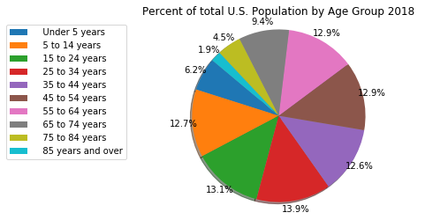
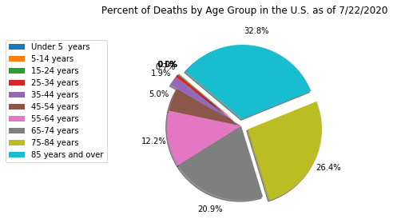
Percentage of Deaths by Age group vs. the General Population
This shows that over 59% of all deaths in the United Sates from Covid-19 were people aged 75 or older compared to the general population that represents only 6.4% of the total. Therefore, age plays a big factor in rates of death.

Slide 4
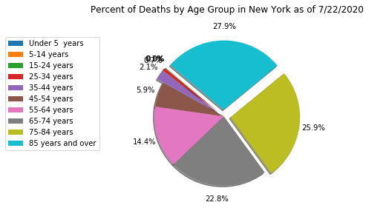
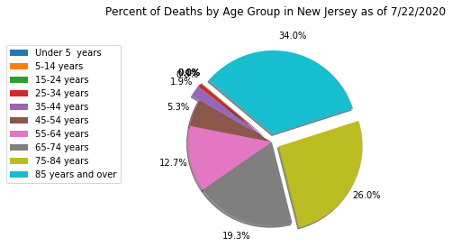
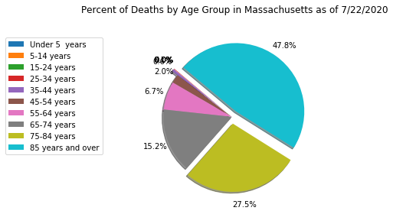
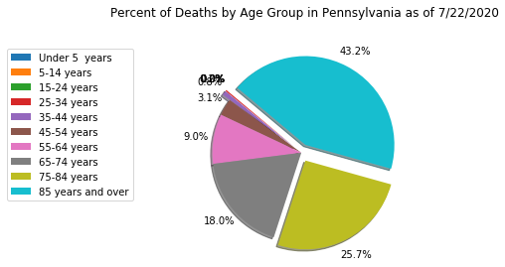
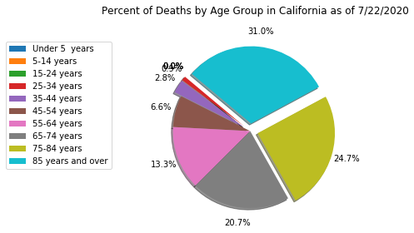
Percentage of Deaths by Age Group Highest Five States
We see that the trend is consistent. Death rates increases with age.

